Slide 1
Digital Media Technology Week 1

Slide 2





Delpher: 90,000 books; 1 million newspapers
DBNL: ca. 4,000 books
Project Gutenberg: ca. 55,000 texts
Google Books: ca. 40 million titles
EEBO and ECCO: 100,000 titles
Text Creation Partnership: Phase 1 has ca. 20,000 fully encoded texts

Slide 3


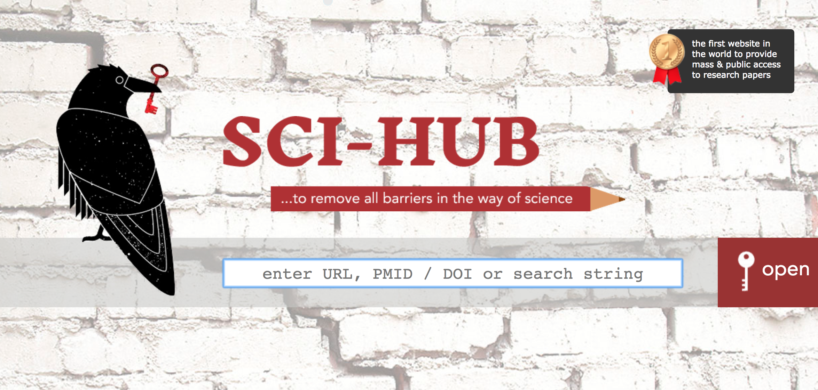
CORE: 134 mln articles
BASE: 120 mln articles
Project Gutenberg: ca. 55,000 texts
Elsevier: Access to 5 mln articles via API
Sci-hub: Ca. 70 mln articles

Slide 4
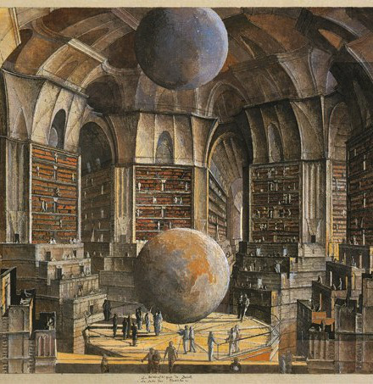
Difficult to make a productive use of these data
Heterogeneous materials with ambiguous and implicit information

Slide 5
Distinction between technical access and intellectual access
Challenge of controlling the chaos is the central theme of DMT

Slide 6
Digital Media Technology
A practical introduction to a number of techniques for the creation, enrichment, storage and dissemination of digital information
Three main topics:
W1-5: Text Encoding (XML, TEI)
W6-8: Stylesheets (XSLT)
W9-12: Database theory (SQL, ERM)

Slide 7
Technologies
HTML
CSS
FTP
XML
TEI
XSLT
XSL:FO
SQL
PHP
Javascript
Mac users?

Slide 8
Modelling
Willard McCarty argues that computers support “the heuristic process of constructing and manipulating models”.
John Unsworth views computer-based humanistic research as "a practice of representation" or "a form of modelling".
Willard McCarty, Humanities computing (Basingstoke; New York: Palgrave Macmillan 2005), p. 23. John Unsworth, 'What is Humanities Computing and What is Not?', in: Melissa Terras, Julianne Nyhan, & Edward Vanhoutte (eds.), Defining digital humanities: a reader, 2013, pp. 36–37

Slide 9
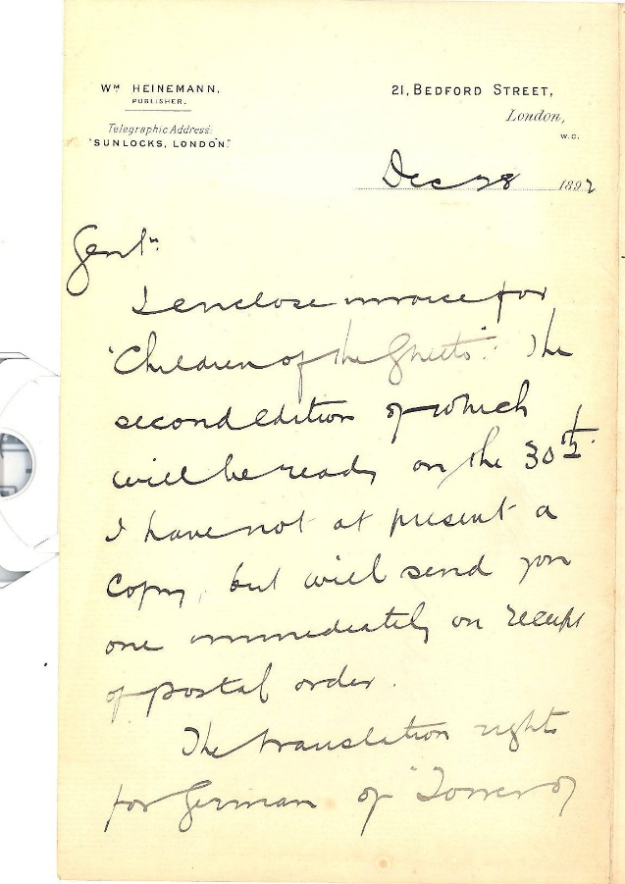
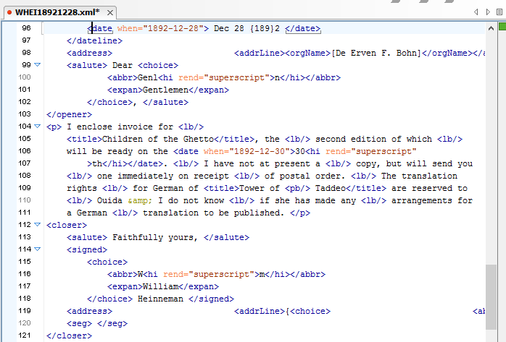

Slide 10
Organisation
Theory and practice: Lectures and seminars
No prior knowledge necessary
Weekly programme: www.digitalscholarship.nl/DMT and www.bookandbyte.org
Blackboard will be used sparsely
Grade is based on four assignments and homework assignments

Slide 11
Computer science needs the humanities to address some its central questions
For humanists, learning about computational methods can open up new perspectives

Slide 12
Have you ever studied a foreign language?
Do you play a musical instrument at any level of proficiency?
Have you ever read the manual of a new technical appliance that you have bought?
When your bike breaks, do you try to fix it yourself or call the shop?
Do you like to play chess? Or go? Or bridge? Any other difficult game?
Stephen Ramsay, Learning to Program

Slide 13


Slide 14
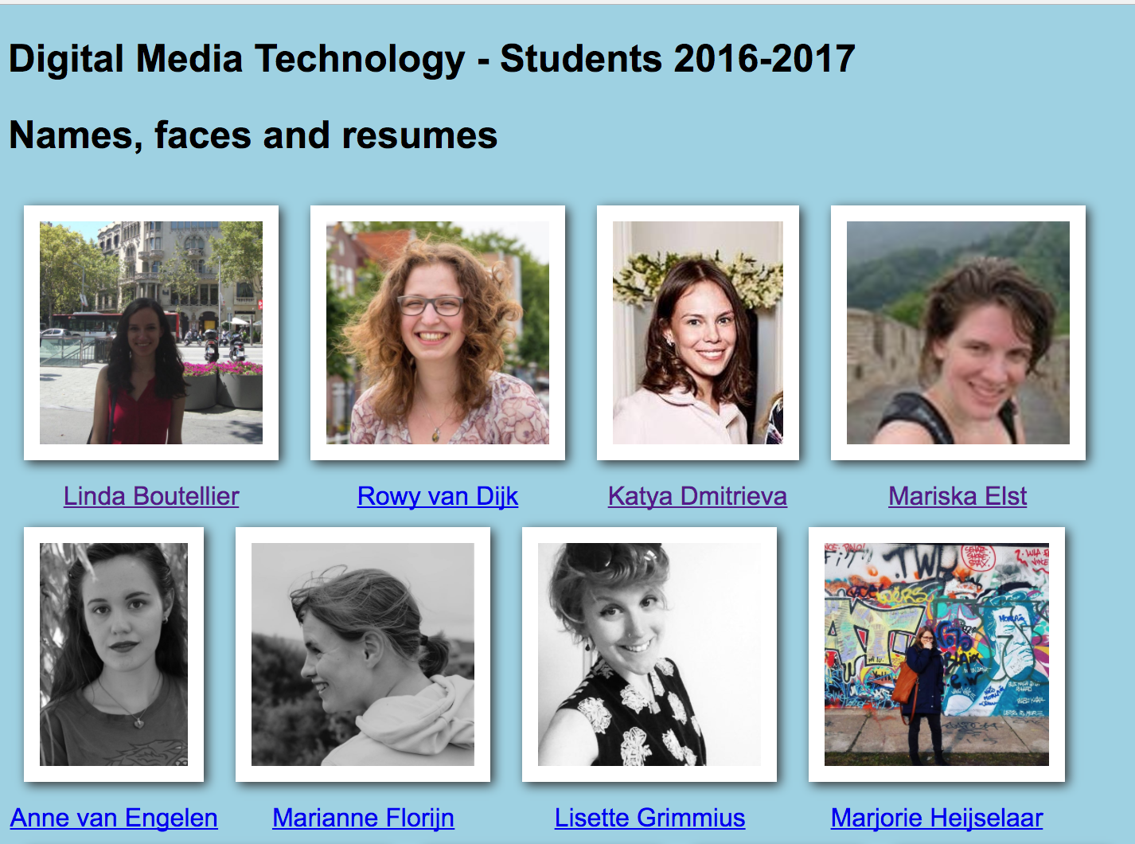

Slide 15
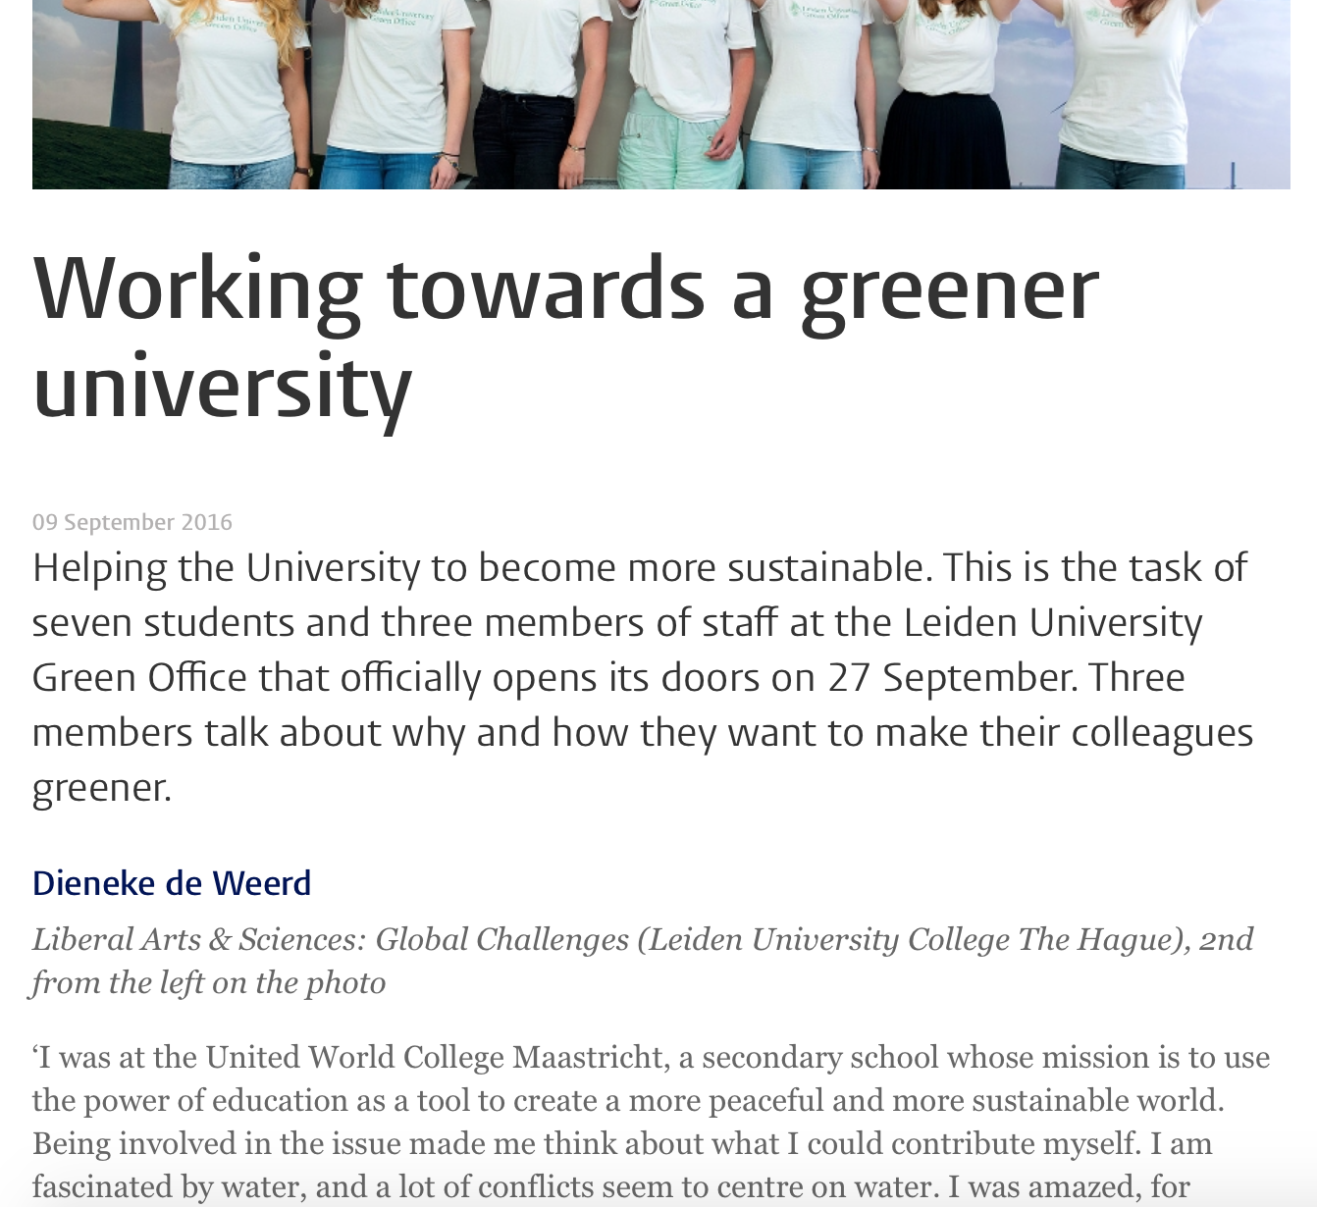
Hypertext Markup Language
Technique used to create web pages
<h1>Working towards a greener university</h1>
<time>09 September 2016</time>
<p>Helping the University to become more sustainable. This is the task of seven students and three members of staff at the Leiden University Green Office that officially opens its doors on 27 September.</p>

Slide 16
Encoding in HTML
Consists of code to specify the formatting
p paragraph
h1/h2/h3 heading
b bold
i italics
Text to be formatted is surrounded by an opening and a closing tag: <p> and </p>
Example:
<b>This text is shown in bold</b>

